Slide 1
Past, Present and Future of Decentralization

Slide 2
History of Japanese Local Autonomy System
Year
Local Autonomy System
Related events
1868
1871
1878
1880
1888
1889
1890
○ Territory of former Shogunate was divided into prefectures.
○ The Law for Family Registers was enacted. ・ Establishment of Ku (administrative section) throughout the country, allocation of heads and vice-heads of Ko
○ Abolition of clans and establishment of prefectures; governors were appointed in prefectures.
○ Establishment of gun, ku, town, and village under prefecture.
○ Establishment of prefectural assemblies of publicly elected parliament members in prefectures
○ Establishment of local tax rules
○ Establishment of municipal assemblies publicly elected in municipalities, granting of decisions on public matters, methods of disbursement and collection of costs therefor
○ Collapse of Edo Shogunate
(Established in 1603)
○ Promulgation of Constitution of Empire of Japan
○ Establishment of municipal system ・ Granting of independent juridical status to municipalities, resolution of public and delegated matters, right to establish local ordinances and rules ・ Municipal assembly: members – publicly elected honorable members based on classified election of citizens; role – decisions on all matters relating to municipalities and delegated matters ・ Management: city – mayor and city council (members – mayor, vice-mayor, honorable council members), municipalities: head of municipality, mayor: appointed by the Minister of Internal Affairs, others: election by municipality assembly
○ Establishment of prefecture system, gun system ・ Prefectures and guns were regulated ・ Prefectural assembly: members – honorable members elected by multiple elections in gun and city in the prefecture; role – decisions on budget, approval of accounts ・ Prefectural council: members – governor, high-ranking officers, honorable council members, role – decisions on delegated matters, urgent matters, stating opinions on matters requested by governor
1

Slide 3
Year
Local Autonomy System
Related events
1899
1911
1921
1926
1943
1946
1947
・ Enforcement organ of prefecture: governor (organ of the central government) – enforcement of decisions by prefectural assembly and prefectural council, management of assets, implementation of construction funded by prefecture
○ Complete amendment of provisions of prefecture/gun system ・ Granting of juridical status to prefectures. Prefectures – subject to supervision by the central government, resolution of public matters and delegated matters within the scope of laws and orders ・Governor – representative of prefecture: outline of its duties, strengthening of power
○ Complete amendment of provisions of city/municipality system ・ Granting of juridical status to municipalities; clarification of power, scope of burden; enforcement organ – independent mayor; city council – sub-organ for decisions; establishment of municipal union system
○ Abolition of gun system ・ Abolition of gun as a local public entity; dual structure; purely an administrative section of the central government
○ Introduction of popular election to municipality/prefecture parliament (males only)
○ Mayor – appointment by city assembly election; abolition of authorization by governor for appointment of head of municipality
○ Establishment of Tokyo Metropolitan Government system ・ Abolition of Tokyo Fu, Tokyo City/Ku; establishment of Tokyo To; establishment of ward having juridical status in the area of former Tokyo City; establishment of director-general of Tokyo as the head of the metropolitan government
○ Public election for the director-general of Tokyo/Hokkaido, governor of prefecture, mayor of municipalities, head of ward in Tokyo; strengthening of power of parliament; granting of right to dissolve parliament to the head; establishment of the system of election control commission, audit committee members; establishment of referendum
○ Enactment of the Local Autonomy Law ・ Integration of systems of Tokyo To, prefecture, municipality; code for systematizing the local autonomy system
○ Implementation of the Local Autonomy Law with the Constitution of Japan (May 3)
○ Enactment of the Constitution of Japan
○ Enactment of the Police Law: establishment of national local police and municipality police (city and with population of more than 5000)
2

Slide 4
Year
Local Autonomy System
Related events
1952
1954
1956
1974
1991
1994
○ Enactment of the Local Finance Law
○ Enactment of the Law for Education Board
Establishment of education board (publicly elected) for municipalities
○ Enactment of the Public Offices Election Law
○ Enactment of the Local Public Service Law
○ Enactment of the Local Tax Law
○ Enactment of the Agricultural Committee
○ Complete amendment of the Police Law: abolition of national local police and municipal police and integration into prefectural police
○ Introduction of a system where municipalities jointly settle works; granting of the right of recommendation to the prime minister, governors; abolition of public election system for the head of special wards
○ Creation of designated city system (designation of Osaka, Nagoya, Kyoto, Yokohama and Kobe)
○ Enactment of the Law on the Organization and Functions of Local Educational Administration; abolition of public election system of education board committee members
○ Resumption of public election system for the head of special wards in Tokyo
○ Review of the system of delegated functions (system of mandamus procedure suit, dismissal of head)
○ Creation of core city system and wide-area cooperatives
3

Slide 5
Year
Local Autonomy System
Related events
1998
1999
○ Designation of special wards as “basic local public entities”; strengthening of autonomy and independence of special wards; transfer of works from the Tokyo Metropolitan Government to special wards (waste disposal, etc.)
○ Amendment of the Local Autonomy Law (Comprehensive Decentralization Law)
① Abolition of the system of delegated functions and creation of autonomous functions and statutory entrusted functions
② Rules are made for the involvement by the central government or prefectures.
③ Creation of dispute resolution system for involvement by the central government and prefectures
④ New relationship between prefectures and municipalities (creation of special exception system for dealing with matters, and others)
⑤ Maintenance of local administrative system (review of fixed number of parliament members, loosening of requirements for core cities, creation of special city system, and others)
4

Slide 6
Goals of Decentralization
Decentralization
○ Transfer of authorities, financial sources, organizations, and personnel to local public entities * Also, transfer from regional governments (prefectures) to local governments (municipalities)
○ Expansion of powers of local governments * From laws, cabinet orders, ministerial ordinances to local ordinances
○ Restructuring of government covering both the central government and local governments such as streamlining of the central government
Challenges facing decentralization
○ To properly reflect the opinions of residents in the operation of local governments
○ To secure fair and transparent operation of local governments
○ To maintain administrative system in local governments (merger of municipalities, etc.)
5

Slide 7
Opinions Raised at Governors’ Meeting (1936)
“Opinions on Improvement of the Administrative Structure” (1936: Governors’ Meeting) (extract)
一 To make efforts to enhance decentralization;
一 To expand local administrative authorities by merging prefectures;
一 To transfer the authorities of central ministries and agencies to local governments where possible;
一 To make efforts to simplify works by streamlining matters subject to authorization, permission or approval of competent ministers;
一 To cause representatives of local governments, officers of local agencies, and representatives of municipalities to participate in the Cabinet Research Bureau;
一 To establish Shu Offices causing them to integrate and communicate matters of central government level of respective prefectures regionally;
一 To establish Do Offices covering several prefectures, with their chief executives being elected officially, and to merge local agencies now belonging to ministries and agencies into them and to cause Do Offices to manage works that are suitable for joint handling by several prefectures based on their entrustment, and to have various test facilities, police training facilities, special classes, etc. comprehensively;
一 To establish an integrating agency for several prefectures under common circumstances and, when such agency is proved to be efficient, to make prefectures simple local autonomous bodies (with the chief executives of prefectures being elected publicly) and to make a local region covering such several prefectures an administrative section
6

Slide 8
Overview of Omnibus Decentralization Law (1999) ①
Clarification of Division of Responsibilities between National and local Governments
○ Local governments are widely responsible for implementing regional administration autonomously and comprehensively
○ National government should concentrate on: ① duties pertaining to the nation’s position in the international community; ② activities of the people that should be specified in a unified, nationwide manner, or affairs relating to basic principles pertaining to local autonomy; ③ implementation of policies and undertakings that must be handled from a nationwide scope and viewpoint; and other matters that should usually be dealt with by the nation.
7

Slide 9
Overview of Omnibus Decentralization Law (1999) ②
● Abolition of the system of delegated functions
System of delegated functions: affairs of the central government performed by enforcement organs of local governments (governors, mayors, etc.) as an agency of the central government under the direction and supervision of ministers
*The system of dismissal of governors of prefectures by ministers was abolished in 1991.
Governor
Minister
Mayor
direction & supervision
Board of Education
abolished
Board of Election
etc.
○ Advice, recommendation
○ Demand for submission of material
○ Demand for correction, instruction for correction
○ Execution by proxy
* No individual involvement such as consent, permission, authorization or approval should be attached if possible.
● Restriction of type of involvement in the Local Autonomy Law
8

Slide 10
Future of Decentralization
● Changes in Japanese society
○ Population decreasing, graying society
○ Unlinked society (problem of missing elderly persons) － Decay of family – regional community – “company”
○ Critical financial situation
Concentration of population in major cities and fading of local communities
(marginal communities, shuttered streets)
“A human cannot live alone, and yet no family, region
or company will take care of me”
● Optimal central government
◆ Strengthening and enhancement of safety net
◆ Restructuring of government by both central and local governments ・ Purification and strengthening of roles of the central government ・ Restructuring of relationship between central and local governments: from advance regulation to subsequent correction ・ Elimination of double administration, reduction in negotiating cost
● Optimal local governments
◆ Reflection of residents’ wishes (optimal parliament/members, referendum)
◆ Internal decentralization within foundation of local government (municipalities) (“autonomous district” with predetermined organization and system)
◆ Restructuring of major city system (ward system in Tokyo, designated city (19 cities) system, etc.)
9

Slide 11
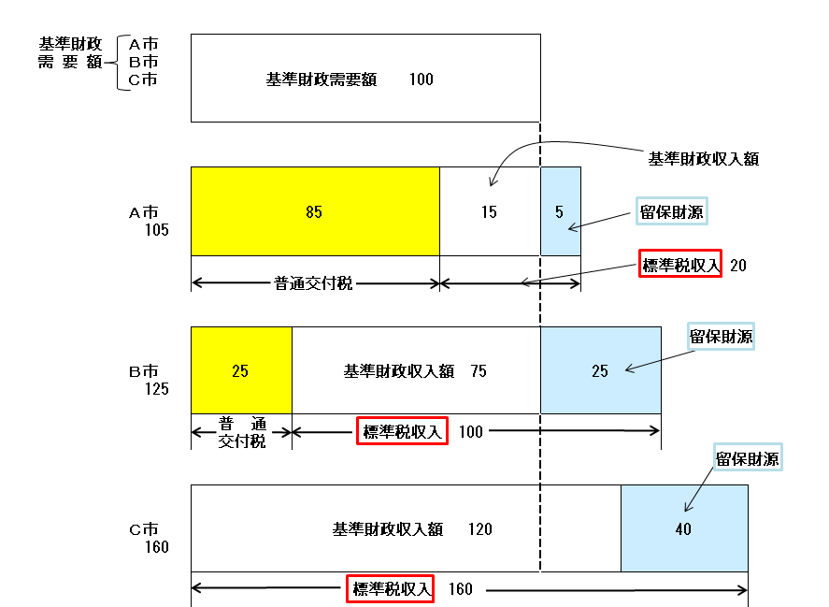
Method of Calculating Ordinary Allocation Tax
(Ordinary allocation tax) = (Base financial needs) － (Base revenues)
Base revenues = Standard projected tax revenue × 75%
Base financial needs
City A
City B
City C
Base financial needs
Base revenues
City A
Reserved revenues
Standard tax revenue
Ordinary allocation tax
Reserved revenues
City B
Base financial needs
Ordinary allocation tax
Standard tax revenue
Reserved revenues
City C
Base financial needs
Standard tax revenue
10
Notes:
10

