Slide 1
Disaster Prevention Systems
Municipal Disaster Prevention Systems and Activities at the Time of the Great East Japan Earthquake

Slide 2
I. Municipal Disaster Prevention System
1. Position in Disaster Countermeasures Basic Act ..........1
2. Division of Roles Under the Disaster Countermeasures Basic Act ..........2
3. Municipal Organizations and Roles ...........3
4. Overview of Municipal Fire Fighting Organizations Etc. .......... 4
5. Voluntary Fire Prevention Organizations ...........7
6. Fire Fighting Support Over a Wide Area and Emergency Response Teams ...........9
Table of Contents
II. Activities During the Great East Japan Earthquake
1. Natural Disasters in Japan ..........11
2. Damage and Fire Fighting Activities During the Great East Japan Earthquake ...........13
3. Damage Data ...........16

Slide 3
Position in Disaster Countermeasures Basic Act
I-1
To protect national land as well as the life, body and property of citizens from disasters such as earthquakes, wind and flood damage, under the Disaster Countermeasure Basic Act, a central disaster prevention council is to be established nationally, and local disaster prevention councils are to be established in prefectures and municipalities. The purpose of these councils is to promote the creation and smooth implementation of disaster plans in order to effectively and appropriately deal with disasters, emergencies, and recovery. The central disaster prevention council is in charge of creating a basic disaster prevention plan, while the local disaster prevention councils are in charge of creating local disaster prevention plans.
If there is a need for emergency measures in the event of a disaster, disaster countermeasures are to be supported by establishing a major disaster countermeasures headquarters on a national level if a major disaster occurs, and an emergency disaster countermeasures headquarters if an remarkably unusual and catastrophic disaster occurs, while prefectures and municipalities are to establish disaster countermeasures headquarters in order to promote disaster countermeasures.
If a disaster actually occurs, prefectures and municipalities are to implement the necessary emergency measures to protect the lives, bodies and property of citizens, as well as to ensure the safety of the area. In particular, as the fundamental local public body, municipalities are to establish evacuation orders and hazard areas, and to take measures for dispatching teams for fire and flood prevention.
1

Slide 4
Division of Roles Under the Disaster Countermeasures Basic Act
I-2
In Japan, municipalities are unambiguously in charge of disaster prevention duties (Disaster Countermeasures Basic Act), while prefectures and the state are positioned as backup and support organizations. At the national level, disaster prevention is headed by the Cabinet Office, and the ministries and agencies involved are wide ranging, and include: the National Police Agency; the Fire and Disaster Management Agency; the Ministry of Land, Infrastructure, Transport, and Tourism; the Geographical Survey Institute; the Meteorological Agency; the Ministry of Education, Culture, Sports, Science, and Technology; the Ministry of Health, Labour and Welfare; and the Ministry of Defense.
Central government | Prefectures | Municipalities
Performs tasks such as creating and generally coordinating disaster prevention plans, establishing disaster prevention infrastructure such as dams and seawalls, and communicating disaster predictions and information. | Performs tasks such as creating and generally coordinating disaster prevention plans, requesting the implementation of emergency measures to the relevant ministries and agencies, and supporting and coordinating the implementation of municipal duties and affairs. | Performs tasks such as establishing a disaster prevention plan and preparing emergency supplies to protect residents, and organizing and maintaining fire services and flood prevention teams. → Grants municipal mayors the authority to establish evacuation instructions and hazard areas, and to provide funds for public emergencies, etc. [Municipalities have the primary obligation to deal with disasters.]
○ Inspect, maintain and stockpile materials and supplies necessary for disaster prevention ○ Improve the maintenance of organizations for communicating disaster predictions and information ○ Collect and communicate disaster-related information | ○ Inspect, maintain and stockpile materials and supplies necessary for disaster prevention ○ Improve the maintenance of organizations for communicating disaster predictions and information ○ Collect and communicate disaster-related information ○ Submit reports to the central government summarizing the disaster situation and measures taken in response ○ Communicate disaster-related forecasts and warnings to the central government ○ Mayor provides coordinates efforts so that emergency measures are implemented accurately and smoothly ○ Request the implementation of emergency measures to the relevant organizations (ministries and agencies etc.) ○ Perform emergency measures in the event that a municipality is unable to do so ○ Obligated to respond to requests for emergency measures from other prefectural governors | ○ Inspect, maintain and stockpile materials and supplies necessary for disaster prevention ○ Improve the maintenance of organizations for communicating disaster predictions and information ○ Collect and communicate disaster-related information ○ Submit reports to the prefecture summarizing the disaster situation and measures taken in response ○ Communicate disaster-related forecasts and warnings to citizens ○ Prepare and order the dispatch of teams to fight fires and prevent floods ○ Implement necessary emergency measures to defend against the occurrence and spread of a disaster ○ Obligated to respond to requests for emergency measures from other municipal mayors
2

Slide 5
Municipality Organizations and Roles
I-3
Municipalities have the primary obligation to deal with disasters, and should provide fire fighting organizations to perform appropriate duties.
Full-time fire fighting organizations
Full-time fire fighting organizations are fire department headquarters and fire stations established by municipalities where full-time staff are employed.
Part-time fire fighting organizations (fire brigades)
Fire brigades are part-time fire fighting organizations in municipalities where members participate in fire fighting and disaster activities in addition to having regular jobs based on a spirit of local patriotism in which one protects one's own area.
Voluntary Disaster Prevention Organizations
Voluntary disaster prevention organizations are organized based on the conscious cooperation of local residents. Under ordinary circumstances, these organizations disseminate disaster prevention knowledge and implement disaster prevention training. During a disaster, they perform tasks such as collecting information, preventing fires and extinguishing fires in the early stages, and conducting evacuations.
3

Slide 6
I–4
Overview of Municipal Fire Fighting Organizations Etc.
Current as of April 1, 2011
(Data for Iwate, Miyagi and Fukushima prefectures were compiled according to the figures from the previous year (as of April 1, 2010) due to the impact of the Great East Japan Earthquake.)
Full-time fire fighting organizations:
About 159,000 members
Fire fighting
organizations
Activities under the jurisdiction of fire chiefs in the districts of all regions
Including about 20,000 females
Fire brigades:
about 880,000 members
Voluntary disaster prevention organizations:
about 37.98 million people
Voluntarily respond to disasters in own region

Slide 7
I–4
Current Situation Regarding Fire Brigades
◆ Characteristics of fire brigades
○ Two types under Article 9 of the Fire Organization Act: Full-time fire fighting organizations and fire brigades (part-time fire fighting organizations)
○ Fundamentally volunteers (local specially-appointed, part-time government employees)
○ Core presence for local fire and disaster prevention (personnel are mobilized as necessary, stay in the local area, and are able to respond immediately)
◆ Targets  Current situation (as of April 1, 2011)
• At least one million fire brigade members nationwide • Number of fire brigade members has dropped to about 880,000 members
• Including at least 100,000 female fire brigade members • Ratio of employed fire brigade members is 71.0%
Number of fire brigade members
Number of female fire brigade members
Number of fire brigade members
Number of female fire brigade members
Note: The above figures are current as of April 1, 2011(data for Iwate, Miyagi and Fukushima prefectures were compiled according to the figures from the previous year (as of April 1, 2010) due to the impact of the Great East Japan Earthquake.)
Notes:
●消防団は、減少傾向にあり、確保に力を入れているところ。

Slide 8
I–4
Changes Over Time in Number of Fire Brigade Members and Ratio of Employed Members
Current situation and issues regarding fire brigades
◆ Number of fire brigade members has dropped to about 880,000
◆ Ratio of fire employed brigade members is 71.0% (as of April 1, 2011)
Number of fire brigade members
Percentage of employed members
Percentage of employed members
Number of fire brigade members
Note: The above figures are current as of April 1, 2011 (Data for Iwate, Miyagi and Fukushima prefectures were compiled according to figures from the previous year (as of April 1, 2010) due to the impact of the Great East Japan Earthquake.)

Slide 9
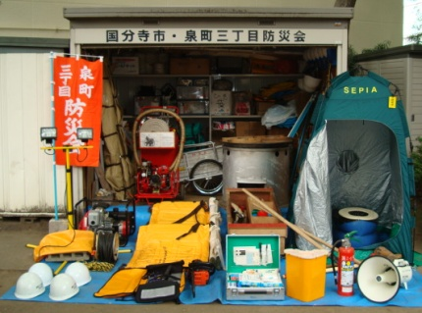
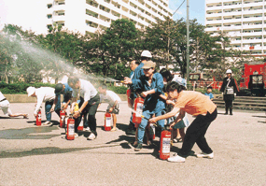
Voluntary Disaster Prevention Organizations
I-5
Organizations voluntarily formed by local residents who carry out disaster prevention activities based on a desire to protect their local area.
– Defined in the Disaster Countermeasures Basic Act as "voluntary disaster prevention organizations based on the spirit of helping neighbors".
Mainly established and operated at the neighborhood/resident association level, and composed of residents living in the area (as of April 1, 2011, there were 146,369 organizations and about 37.98 million members).
These organizations are extremely important for providing self-help and mutual assistance when government organizations are struggling with rescue operations during a large-scale disaster.
Main activities
Voluntary disaster prevention organizations
Under ordinary circumstances:
Disseminate disaster prevention knowledge
Ascertain locations in the area that will be dangerous in a disaster
Carry out disaster prevention training
Inspect equipment at facilities that use fire
Store, organize and inspect disaster prevention equipment
During a disaster:
Gather disaster-related information, and rapidly convey it to residents
Prevent fires and initiate fire fighting
Conduct evacuations
Rescue and provide first-aid to disaster victims
Supply food and water
Implement training under ordinary circumstances
Take action during a disaster
Self-help
Mutual assistance
Disaster prevention storehouse and materials
Regional disaster prevention force
Minimize damage
during a disaster
Government assistance
Disaster prevention training
✰ To encourage voluntary disaster prevention organizations, aid is provided to municipalities to buy disaster prevention equipment and to cover operating costs, and the organizations are supplied with fire prevention equipment.
✰ The Fire and Disaster Management Agency prepares and distributes guidelines (guidance) to facilitate activities by the voluntary disaster prevention organizations, and delivers seminars etc. to encourage activity by the organizations.
Improves regional disaster prevention force
7
Note: Data from Iwate, Miyagi and Fukushima prefectures were compiled according to figures from the previous year (as of April 1, 2010) due to the impact of the Great East Japan Earthquake.

Slide 10
Changes Over Time in Voluntary Disaster Prevention Organizations
I-5
Percentage of activities covered by voluntary disaster
Percentage of activities covered by
voluntary disaster prevention organizations
Number of voluntary disaster prevention organizations
prevention organizations
(Current as of April 1, 2011)
Note 1: The percentage of activities covered by voluntary disaster prevention organizations is the number of households involved in voluntary disaster prevention activities as a percentage of the total number of households.
Note 2: Data for Iwate, Miyagi and Fukushima prefectures were compiled according to figures from the previous year (as of April 1, 2010) due to the impact of the Great East Japan Earthquake.
Notes:
●非常に伸びてきており心強いところ。

Slide 11
Fire Fighting Support Over a Wide Area and Emergency Response Teams
I-6
Mutual Fire Fighting Support Agreements
Since municipalities are obligated to make an effort to provide mutual support for fire fighting if required, signing agreements on mutual support for fire fighting enables fire fighting forces to operate over a wider area beyond a municipality or prefectures in order to be able to respond appropriately to large-scales disasters and special disasters.
Emergency response teams
Based on lessons learnt from the Great Hanshin-Awaji Earthquake, emergency response teams were established to build a rescue system involving the mutual support of fire fighting organizations nationwide so that survivor rescue operations etc. can be implemented more efficiently and rapidly when a large-scale disaster such as an earthquake occurs in Japan.
In the event of a large-scale disaster in Japan, this is a system in which fire brigades are requested to converge on a disaster area from all over the country by the Commissioner of the Fire and Disaster Management Agency in order to respond to the disaster and to provide relief operations such as rescuing survivors.

Slide 12

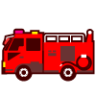

I-6
Fire Fighting Support Over a Wide Area
Regular fires, accidents and disasters
Large-scale fires, accidents and disasters
City A
○ Fire fighting support from emergency response teams neighboring prefectures and nationwide
○ Response by fire fighting organization in relevant municipality
(Number of teams registered as of April 1, 2011: 4,354)
(As directed by the Commissioner of the Fire and Disaster Management Agency)
Actual examples
Earthquake: Niigata Chuetsu Earthquake (2004) , Great East Japan Earthquake (2011)
Flood: Niigata and Fukushima flood (2004) , Fukui flood (2004)
Rescue: JR Fukuchiyama Line derailment accident (2005) , etc. (total of 24 cases)
Number of fire departments nationwide: 798
Number of full-time fire fighters nationwide: 159,000
Number of fire brigade members nationwide: 884,000
(Current as of April 1, 2010, except for number of fire departments, which is current as of April 1, 2011)
Request for support from governor of affected prefecture
Request or order from the Commissioner of the Fire and Disaster Management Agency
Large-scale fires, accidents and disasters
In the event of a local disaster teams are dispatched from neighboring prefectures
Dispatch of emergency fire response teams (area where teams are dispatched from is increased depending on extent of disaster)
○ Fire fighting support from neighboring municipalities (including outside of prefecture) or municipalities within prefecture based on reciprocal fire fighting support agreements
Prefecture A
Number of support agreements within prefectures: 47
Number of agreements between municipalities solely within same prefecture: 1,739
Number of agreements between municipalities outside of prefecture: 569
For the Tokai Earthquake, teams were dispatched from all over the country
Prefecture B
(as of April 1, 2010)

Slide 13
Disasters in Japan Compared to Rest of World
II-1
Number of earthquakes of magnitude 6 or greater
Number of active volcanoes
From 2010 whitepaper on disaster prevention
Japan
212 (20.5%)
Japan
108 (7.0%)
World
1,036
World
1,548
Totals from 2000 to 2009. Prepared by the Cabinet Office based on seismic data from the Japanese Meteorological Agency for Japan, and the US Geological Survey (USGS) for the rest of the world.
Active volcanoes are those that have erupted within about the past 10,000 years. Prepared by the Cabinet Office based on volcano data from the Japanese Meteorological Agency for Japan, and the US Smithsonian Institute for the rest of the world.
Number of disaster victims (‘000 people)
Cost of disasters (billions of dollars)
Japan
9 (0.3%)
Japan
206.8 (11.9%)
World
2,570
World
1,736.1
Totals from 1979 to 2008. Prepared by the Cabinet Office based on data from the Epidemiological Research Centre (CRED), Université catholique de Louvain (Belgium).
Totals from 1979 to 2008. Prepared by the Cabinet Office based on data from CRED.

Slide 14
II-1
Annual Deaths and Missing Persons Due to Natural Disasters
Year | People | Year | People | Year | People | Year | People
1945 | 6,062 | 1962 | 381 | 1979 | 208 | 1996 | 84
1946 | 1,504 | 1963 | 575 | 1980 | 148 | 1997 | 71
1947 | 1,950 | 1964 | 307 | 1981 | 232 | 1998 | 109
1948 | 4,897 | 1965 | 367 | 1982 | 524 | 1999 | 142
1949 | 975 | 1966 | 578 | 1983 | 301 | 2000 | 78
1950 | 1,210 | 1967 | 607 | 1984 | 199 | 2001 | 90
1951 | 1,291 | 1968 | 259 | 1985 | 199 | 2002 | 48
1952 | 449 | 1969 | 183 | 1986 | 148 | 2003 | 62
1953 | 3,212 | 1970 | 163 | 1987 | 69 | 2004 | 327
1954 | 2,926 | 1971 | 350 | 1988 | 93 | 2005 | 148
1955 | 727 | 1972 | 587 | 1989 | 96 | 2006 | 177
1956 | 765 | 1973 | 85 | 1990 | 123 | 2007 | 41
1957 | 1,515 | 1974 | 324 | 1991 | 190 | 2008 | 101
1958 | 2,120 | 1975 | 213 | 1992 | 19 | 2009 | 115
1959 | 5,868 | 1976 | 273 | 1993 | 438 | 2010 | 146
1960 | 528 | 1977 | 174 | 1994 | 39 | 2011 | 15,270
1961 | 902 | 1978 | 153 | 1995 | 6,482 |  | 8,499
(Taken from 2011 disaster prevention whitepaper)
Deaths: 15,270
Mikawa Earthquake & Makurazaki Typhoon
Dead: 4,779
Missing: 1,283
Nanki Flood, Typhoon No. 13, etc
Dead: 2,144
Missing: 901
Fukui Earthquake
Dead: 3,769
Missing: 6
Missing: 8,499
6,062
5,868
Great Hanshin-Awaji Earthquake
Dead: 6,434
Missing: 3
6,482
4,897
Ise Bay Typhoon
Dead: 4,697
Missing: 401
3,212
Niigata Chuetsu Earthquake
Dead: 68
Nankai Earthquake
Dead: 1,330
327
Note: The number of deaths and missing persons in 2011 applies only to the Great East Japan Earthquake (current as of May 30, 2011)

Slide 15
II-2
Damage and Fire Fighting Activities During the Great East Japan Earthquake (1) (damage situation)
The Great East Japan Earthquake struck on March 11, 2011 at 2:46 PM, with the epicenter in Sanrikuoki (magnitude 9.0; maximum seismic intensity of 7 in Kurihara City, Miyagi), causing immense damage throughout Eastern Japan.
Characteristics of the disaster
○ Largest recorded earthquake in Japanese history (magnitude 9.0). Immense destruction continued to occur along 3 faults covering an area about 450 km long and 200 km wide. The earthquake continued for over 6 minutes in Tohoku (in Sendai, where a seismic intensity of 6 was measured, there were 4 large quakes in that time).
Note: The destruction of the faults started offshore from Miyagi prefecture and spread to areas offshore from Iwate, Fukushima and Ibaraki prefectures.
○ The human losses and physical damage caused by the tsunami were immense.
○ Damage occurred in an extensive area (the worst human losses and physical damage occurred in the Tohoku region, but reached all over Eastern Japan).
○ As many as 550,000 people were evacuated (as of March 15), and many are still unable to return to their homes (70,077 people as of January 11, 2012).
○ The tsunami caused the Fukushima Dai-ichi Nuclear Power Plant accident.
○ There have been 580 aftershocks to this point (magnitude 5.0 or greater).
Source: Meteorological Agency; current as of January 10, 2012
Summary of the disaster
(Source: Fire and Disaster Management Agency; current as of Jan. 11, 2012)
(Source: Fire and Disaster Management Agency; current as of Jan. 11, 2012)
Property damage | Iwate | Miyagi | Fukushima
Completely destroyed: 128,497 | 20,184 | 84,062 | 19,781
Partially destroyed: 240,090 | 4,552 | 136,712 | 61,925
Partially damaged: 677,502 | 7,316 | 212,994 | 142,166
Human losses | Iwate | Miyagi | Fukushima
Number of deaths: 16,131 | 4,665 | 9,472 | 1,925
Number of people missing: 3,240 (as notified to the authorities) | 1,427 | 1,805 | 63
Number of people injured: 5,994 | 188 | 4,015 | 181
Note: These figures are from areas flooded and destroyed by the tsunami. Many municipalities are still being surveyed.
(Source: Fire and Disaster Management Agency; current as of Jan. 11, 2012)
Number of fires that occurred | Iwate | Miyagi | Fukushima
286 | 34 | 135 | 11
Note: The above figures were reported from each prefecture. Many municipalities are still being surveyed.
Note: Many of the fires that broke out are thought to have been caused by the tsunami.

Slide 16
II-2
Damage and Fire Fighting Activities During the Great East Japan Earthquake (2) (injuries/damage to fire fighting organizations in main stricken prefectures)
Main damage/injuries to fire fighting organizations in stricken prefectures
Main injuries/damage to fire departments
(as of April 1, 2011)
Main injuries to fire brigades
(as of April 1, 2011)
Fire fighters | Deaths: 23; missing: 4
Buildings (totally/partially destroyed, or partially damaged) | Fire headquarters/stations: 130 Branches/Dispatch locations: 135
Trucks etc. | Trucks: 77; boats: 2; helicopter: 1*
Fire brigade members | Deaths: 241; missing: 12
Buildings (no longer usable) | Fire brigade facilities (fire stations etc.): 412
Trucks etc. | 257
Note: The above figures have been verified as of this time by reports from the fire department headquarters of Aomori, Iwate, Miyagi, Fukushima, Ibaraki, Tochigi and Chiba with regard to the full-time fire departments, and from Iwate, Miyagi and Fukushima with regard to fire brigades. Some municipalities are still being surveyed with regard to fire brigades, so the figures are unknown.
*A helicopter from the Miyagi Disaster Prevention Air Corp was swept away by the tsunami while parked in a Sendai Fire Department heliport (Wakabayashi District, Sendai City), and is no longer usable.
Comments: Examples of reports of activities by fire brigade members
Fire Bell Continued to Ring: 11 fire Brigade Members Dead or Missing (Mainichi Shimbun, March 23)
Members of the second brigade (Chief: Hiroshi Koshida; 28 members) in Otsuchi-cho in Iwate prefecture, where over 2,000 people died or are missing due to the Great East Japan Earthquake, closed the tide wall gate and remained on the coast until the very end in an effort to evacuate citizens. As a result of carrying out their duties, 4 members died and 7 are missing. One member, Fujio Koshida, continued to ring the fire bell, which is a symbol of the brigade, and was eventually swept away by the tsunami.
Dispatched Immediately After Earthquake: 26 Fire Brigade Members Dead or Missing (Yomiuri Shimbun, Morning Edition, March 28)
The members of the Takata Fire Brigade (about 120 members) of Rikuzentakata City, Iwate, closed tide wall gates in 5 locations immediately after the earthquake. However, the great tsunami overwhelmed the tide walls, sweeping away members involved in evacuating residents. Twenty-six members died or are missing. The remaining members, who are proud of being the defenders of the area, continued clearing debris and searching for missing people soon after mourning the loss of their colleagues.
Fire Brigade Member Held Mic and Announced Evacuation Until Very End (Tokyo Shimbun, Morning Edition, March 21)
A member of the fire brigade, who announced to residents to “please escape to higher ground” via loudspeaker on the day of the earthquake, was swallowed up by the tsunami. It would be the final announcement of Ayumu Sakurai (46) of Natorishi, Iwate. The fire engine he was in was swept away and crushed, and the three members in it were found dead. Mr. Sakurai, who was in the passenger seat, was still gripping a microphone in his right hand.
さくらいあゆむ

Slide 17
II-2
Damage and Fire Fighting Activities During the Great East Japan Earthquake (3) (fire fighting support form other prefectures for the disaster-stricken prefectures)
Immediately after the earthquake occurred, emergency response teams from the other 44 prefectures were instructed to dispatch to the three prefectures that were directly affected: Iwate, Miyagi, and Fukushima. (This was the first time teams were dispatched based on instructions).
For a period of 88 days, from March 11, 2011 until activities finished on June 6, the total number of personnel dispatched reached 28,620, equivalent to one in every five or six of fire fighters nationwide.
The air force engaged in activities such as life-saving operations, aerial fire fighting and information gathering, while land forces engaged in activities such as fire fighting, rescue and first-aid. To this point, the total number of people rescued stands at 5,064 (including those rescued in cooperation with local fire departments).
Emergency response teams
Objective
・ To ensure national support for the fire fighting system, and to implement life saving activities, etc. effectively and quickly in the event of a large-scale or special disaster such as an earthquake.
Details of Establishment
Changes over time in emergency response teams and dispatched personnel
・Emergency response teams were established in 1995 based on lessons learned from the Great Hanshin-Awaji Earthquake. Registrations began with the Tokyo Fire Department and the fire departments of other major cities.
・ According to the June 2003 revision of the Fire Organization Act, emergency response teams are clearly positioned from a legal standpoint, and can be dispatched based on orders from the Commissioner of the Fire and Disaster Management Agency.
緊急消防援助隊 出動人員の推移
Time period: March 11 to June 6, 2011 (88 days)
Total personnel: 28,620 (7,577 teams)
Extended personnel: 104,093 (27,544 teams)
Current as of April 62011
Total dispatched: 28,620 (7,577 teams)
Extended personnel: 104,093 (27,544 teams)
Summary
As of June 6, 2011:83 people
(28 teams)
・ The Minister of Internal Affairs and Communication will establish a general plan for organizing and maintaining facilities. The Commissioner of the Fire and Disaster Management Agency will then register teams based on the plan.
・In the event of a large-scale or special disaster, teams will be dispatched by request or order from The Commissioner of the Fire and Disaster Management Agency.
・ As of April, 2011, 783 out of 798 fire departments nationwide were registered.
March 18
Maximum: 6,099 people (1,558 teams)
(1,558隊)
3/12 3/19 3/26 4/2 4/9 4/16 4/23 4/30 5/7 5/14 6/6
March 6
15

Slide 18
[Photograph] Disaster Example (1): Tsunami Reaches Shore (Taro, Miyako City)
Example of tsunami reaching the shore (Taro, Miyako City)

Slide 19
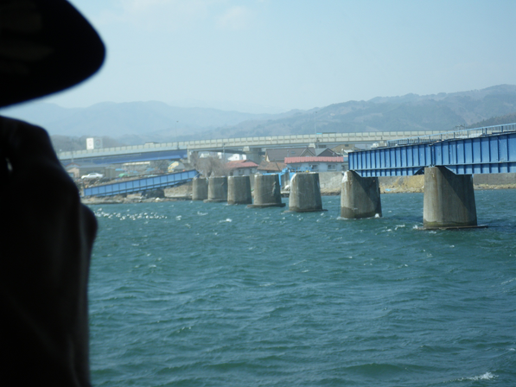
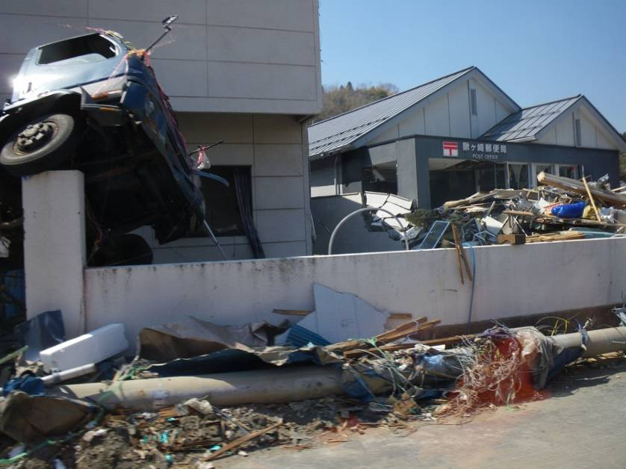
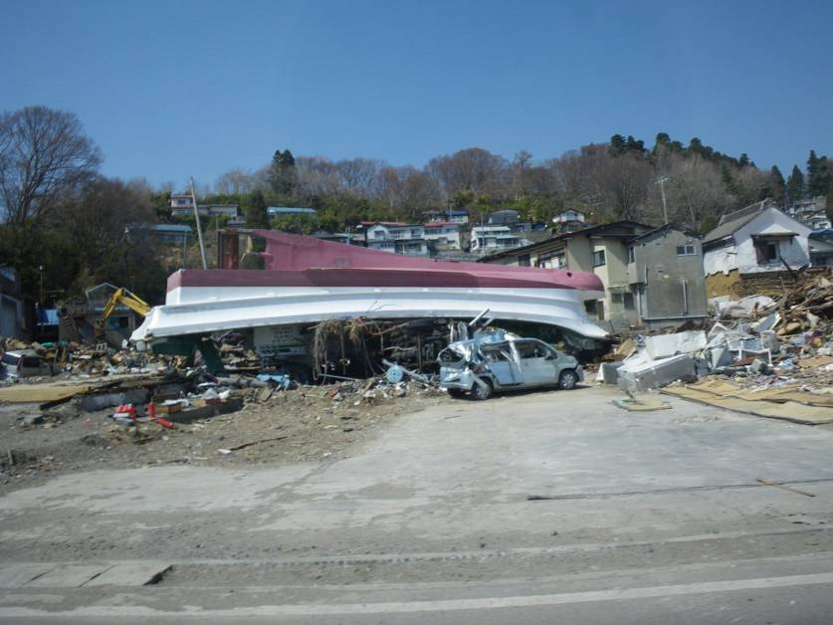
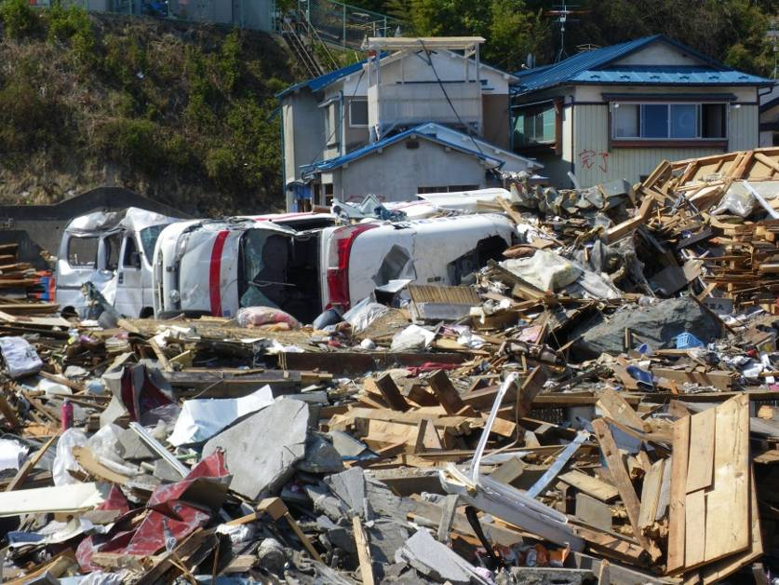
[Photograph] Disaster Example (2) (Kuwagasaki, Miyako City)
Photographs taken April 13, 2011
Notes:
19

Slide 20
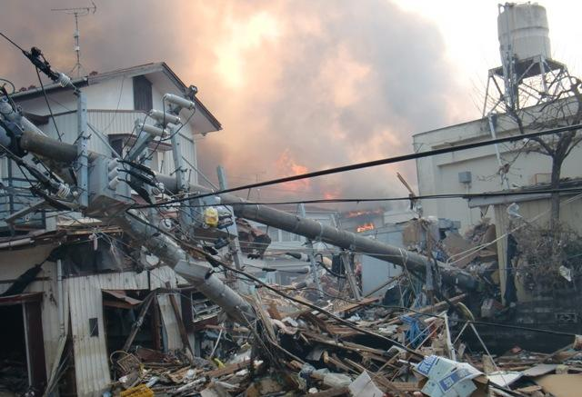
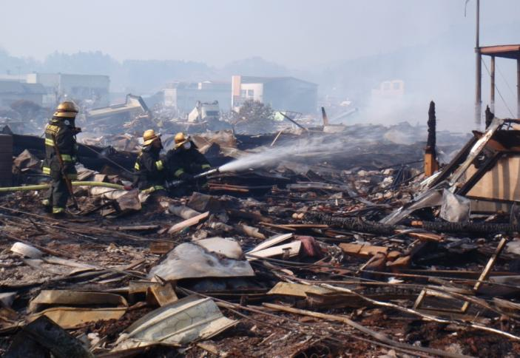
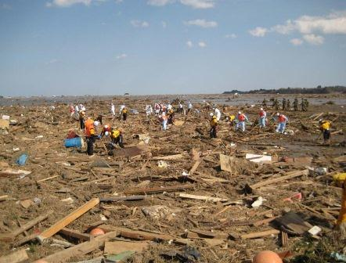
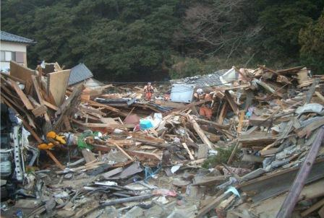
[Photograph] Disaster Example (3) (Activities Undertaken by Fire Brigades)
Fire breaks out
Fire brigade fighting a fire
Searching for survivors in Nikkeshi, Soma City, March 19 (courtesy of Outsu City fire department)
A search in Tairausuiso, Iwaki City, March 14 (courtesy of Shizuoka Fire Department)

Slide 21
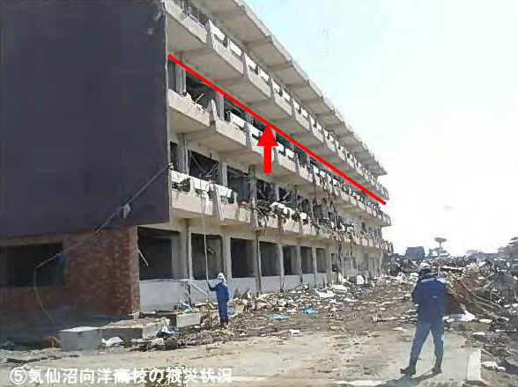
[Photograph] Disaster Example (4) (Damage Due to Tsunami)
Damage done to Kesennuma Koyo High School

Slide 22
[Photograph] Disaster Example (5) (Around JR Ofunato Station)
The situation 26 days after the earthquake
Around JR Ofunato Station
The Situation around JR Ofunato Station (from South)

Slide 23
[Photograph] Disaster Example (6): Situation Before & After Disaster
(Rikuzentakata City, Iwate Prefecture)
Before disaster (October 18, 2010)
After disaster (March 13, 2011)

Slide 24
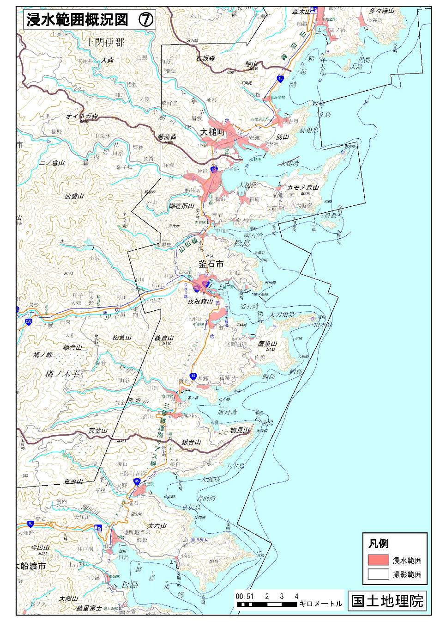
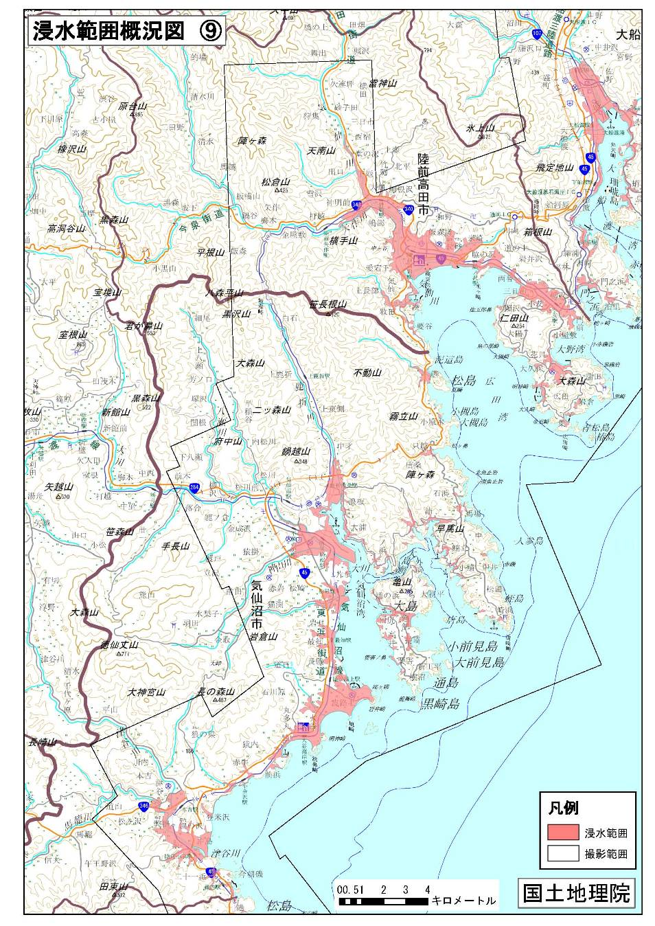
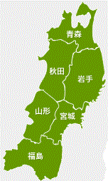
[Photograph] Extent of Flooding by Tsunami Due to Great East Japan Earthquake (1)
Map showing extent of flooding (Iwate)
Map showing extent of flooding (Iwate and Miyagi)
Notes:
三陸の入り組んだ海岸

Slide 25
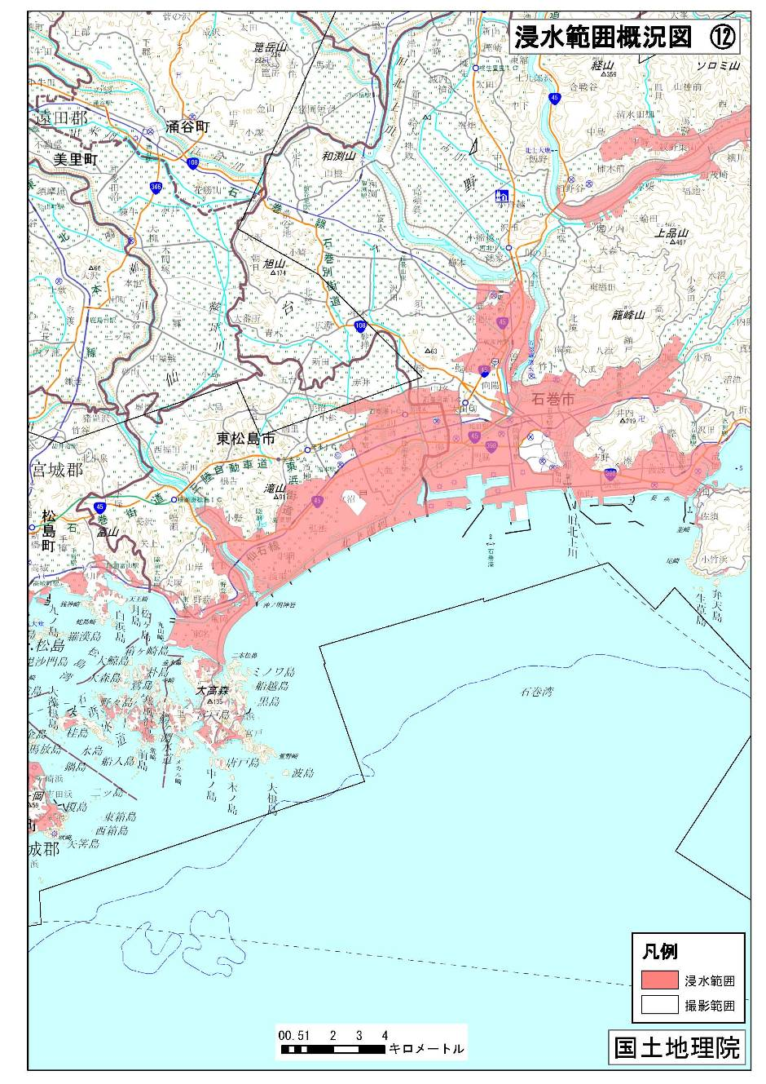
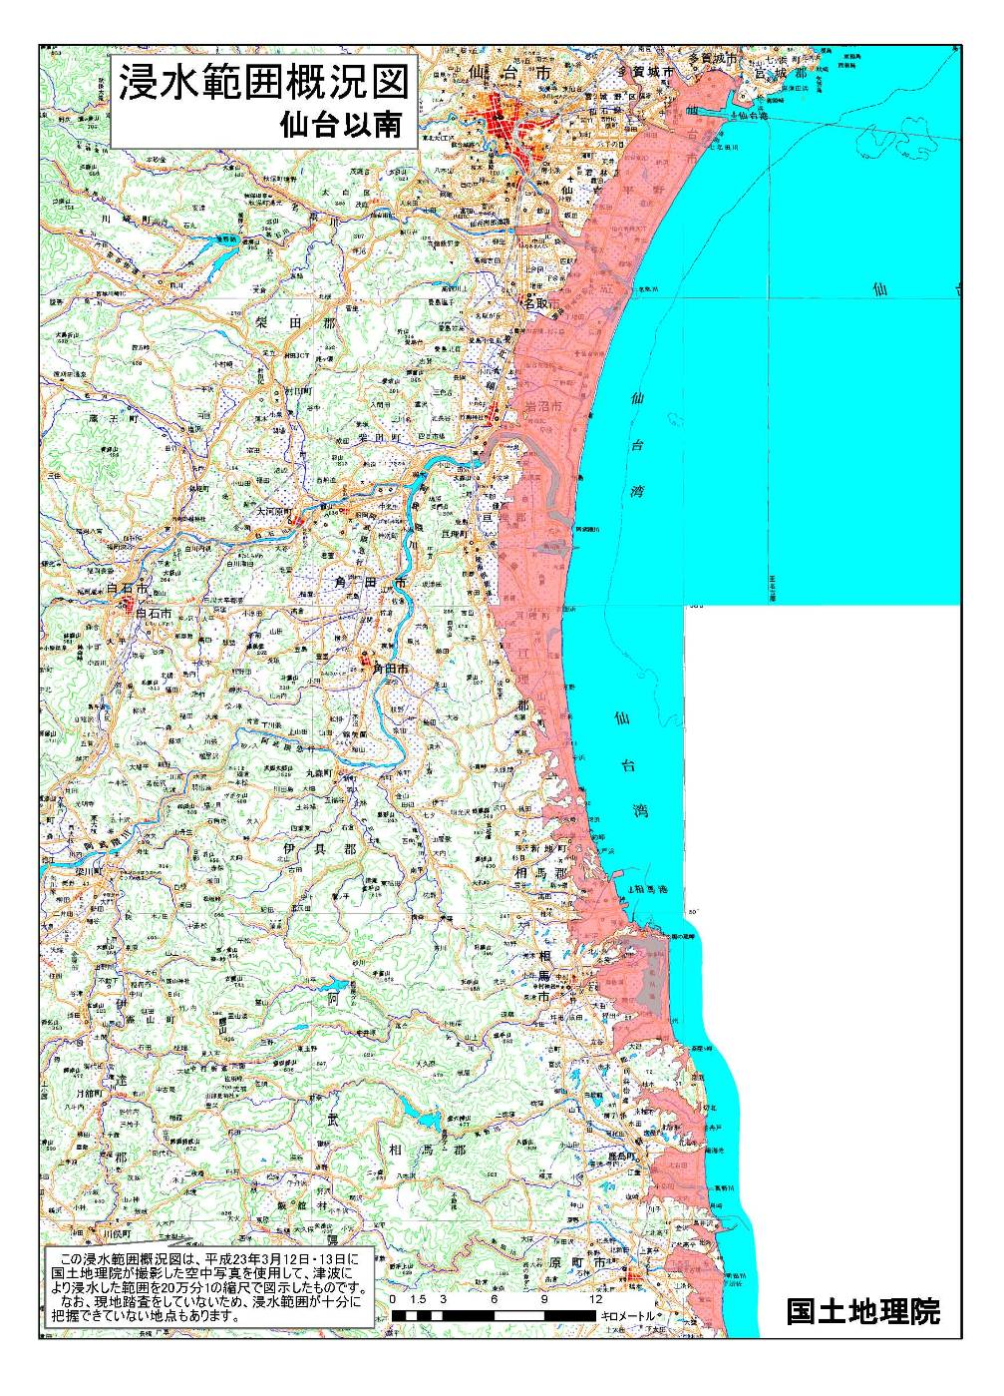
[Photograph] Extent of Flooding by Tsunami Due to Great East Japan Earthquake (2)
Map showing extent of flooding (Miyagi)
Map showing extent of flooding in south Sendai
Notes:
宮城、福島のなだらかな海岸線
ここでの津波被害が特徴

